Slide 1
AWS Cloud- PART I
DevOps Course

Slide 2
Objectives
By the end of this session you’ll gain
Cloud Understanding
IAAS & PAAS
AWS Fundamentals

Slide 3
Cloud Computing(1)
A Model for enabling ubiquitous , convenient, on-demand network access to a shared pool of configurable computing resources ( networks, storage ,servers , applications) that can rapidly provisioned and released with minimal management effort or service provider interaction.

Slide 4
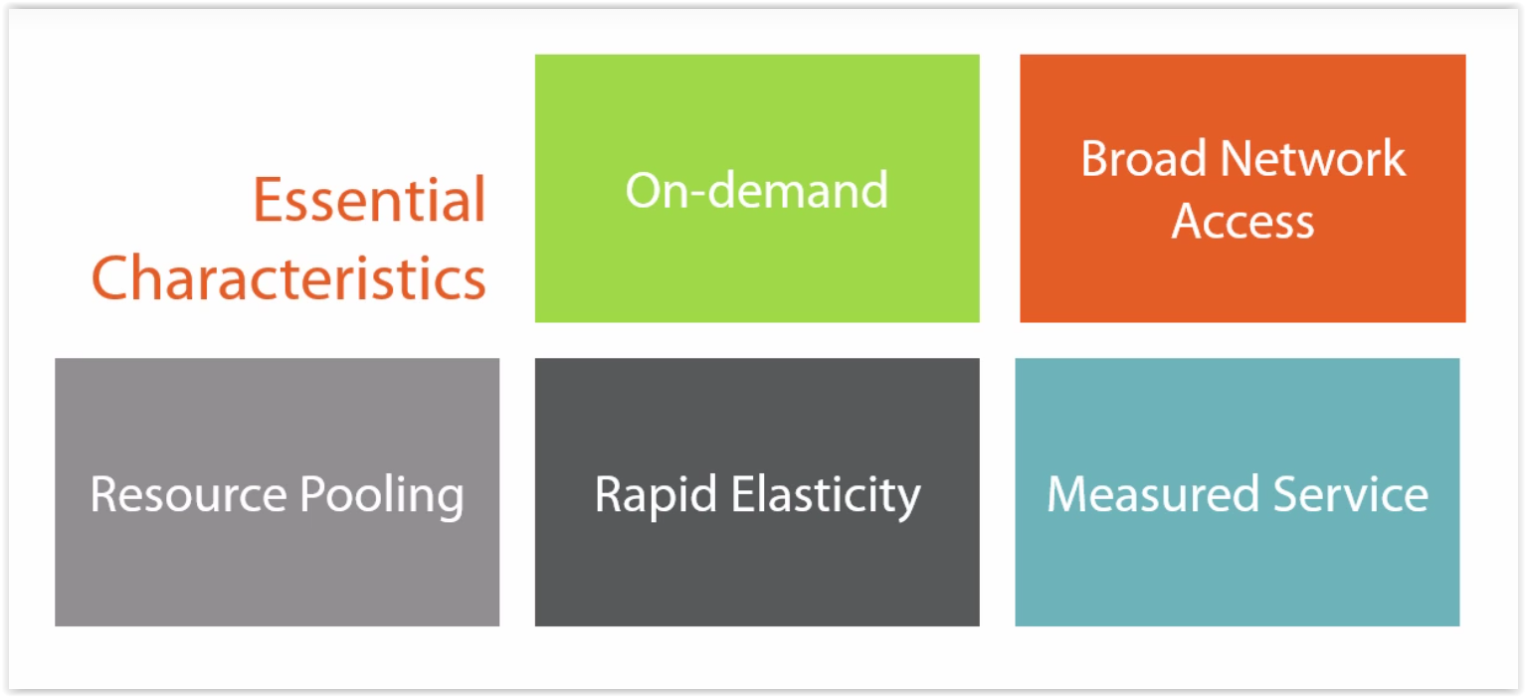
Cloud Computing (2)

Slide 5
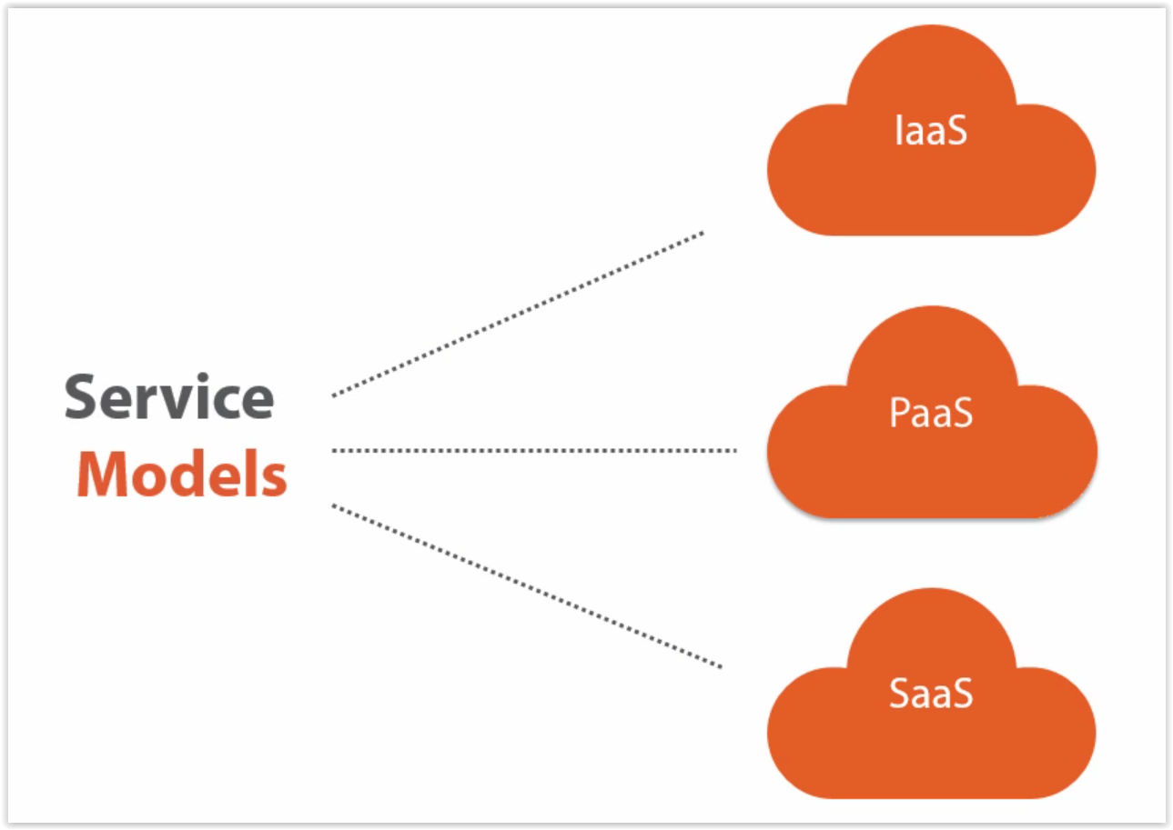
Cloud Computing (3)

Slide 6
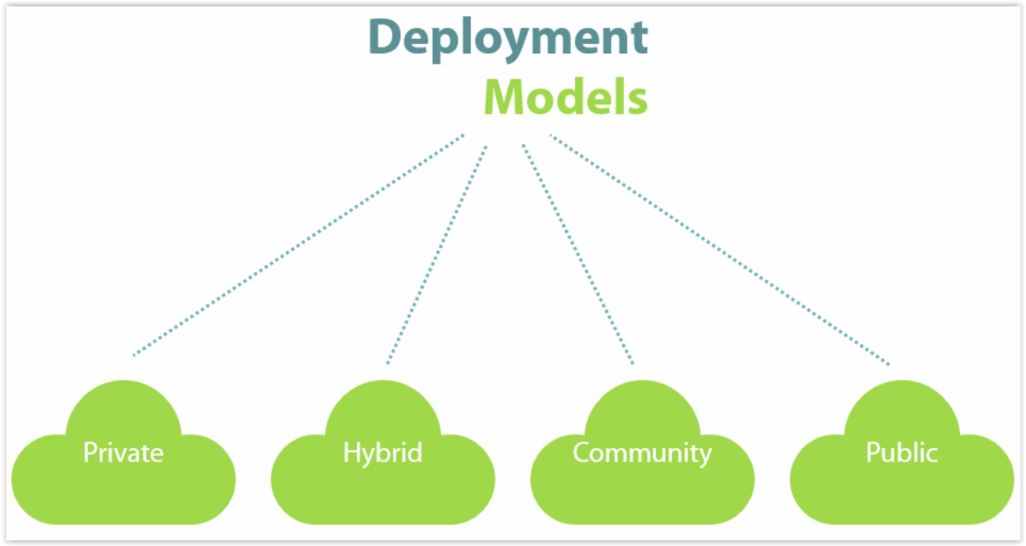
Cloud Computing (4)

Slide 7
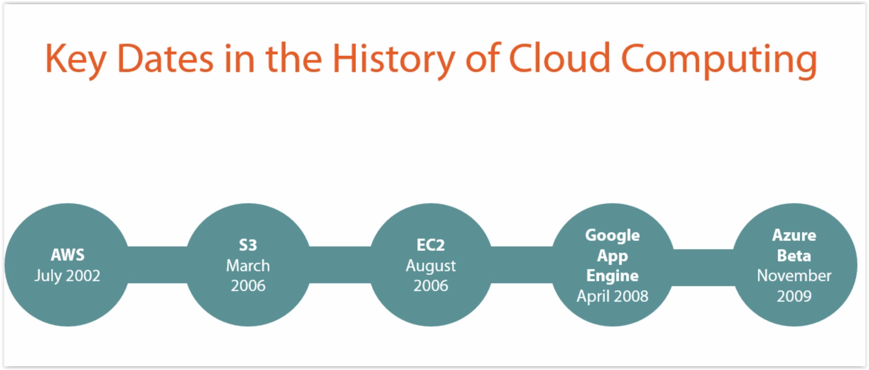

Slide 8
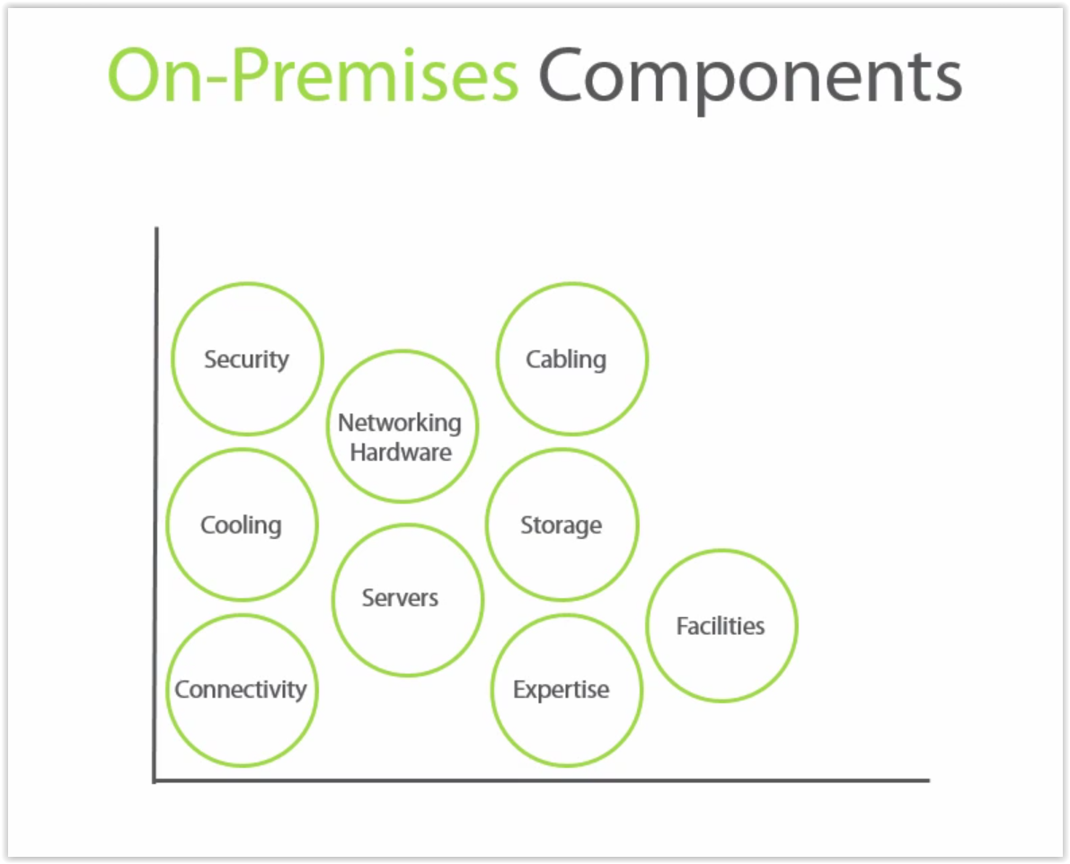

Slide 9
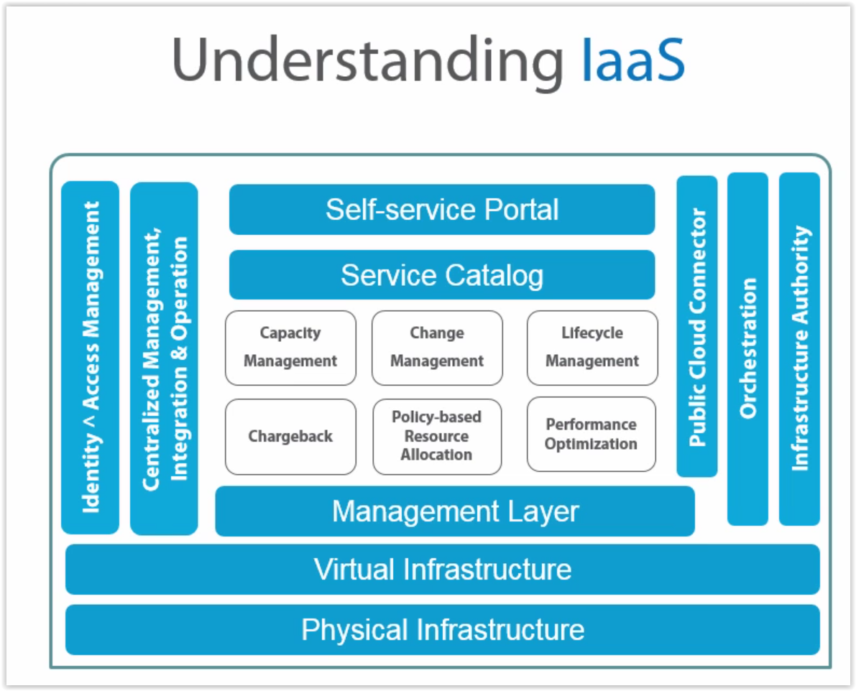

Slide 10
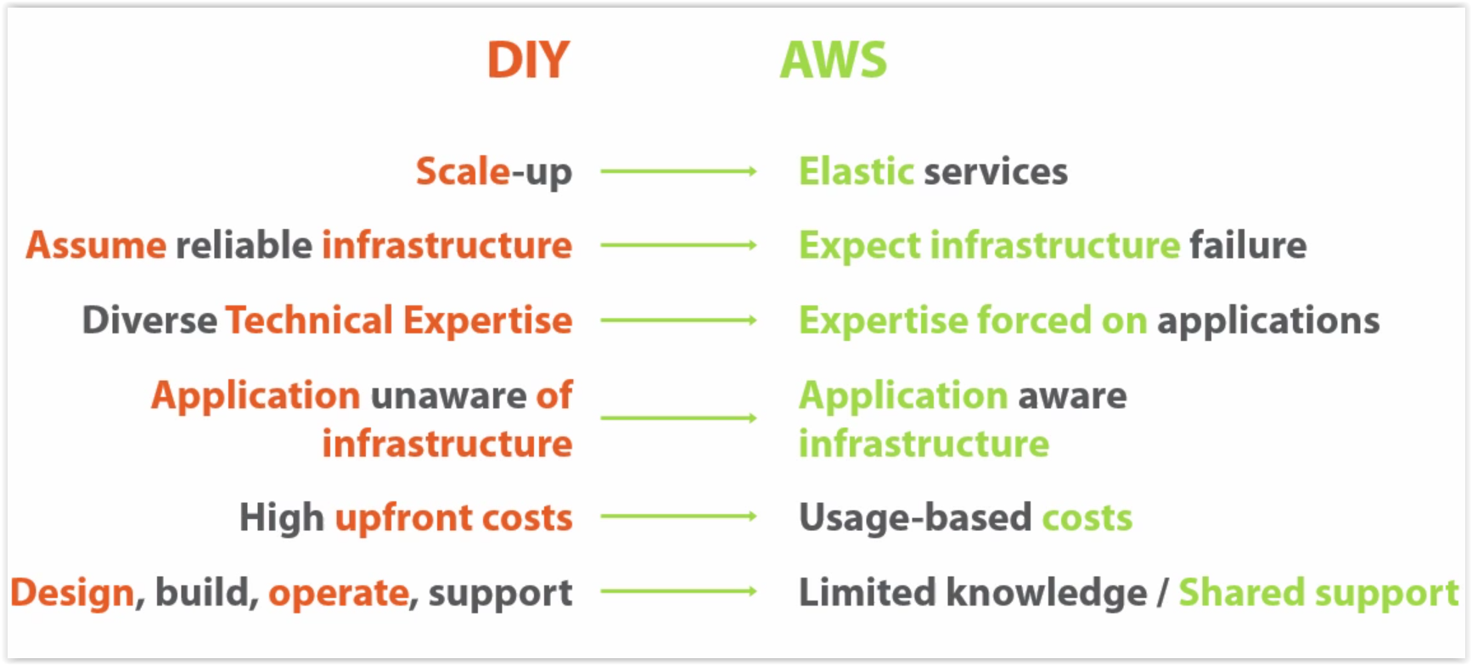
Do It YourSelf VS AWS

Slide 11
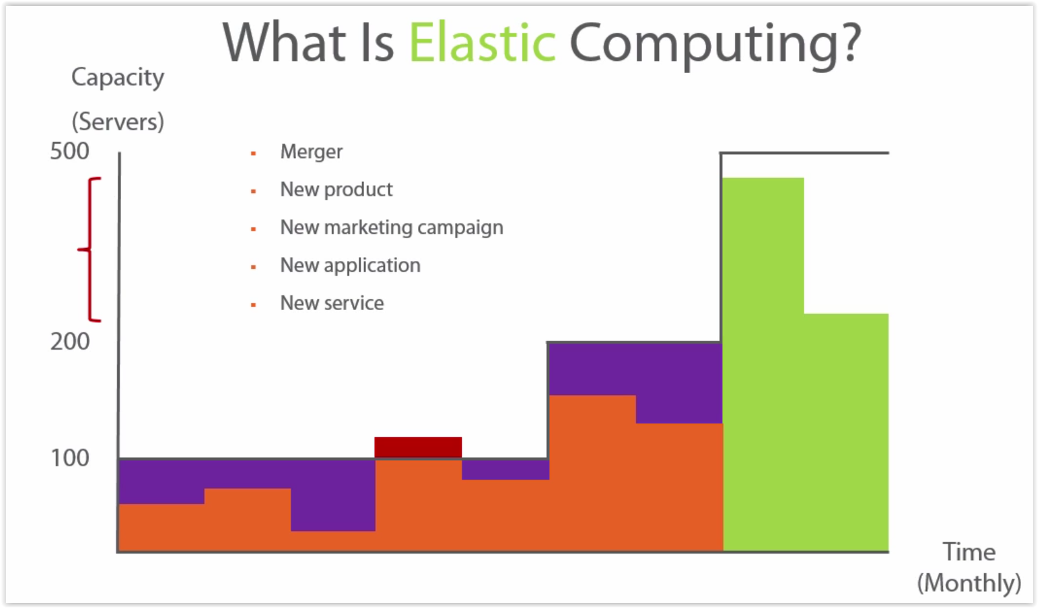

Slide 12
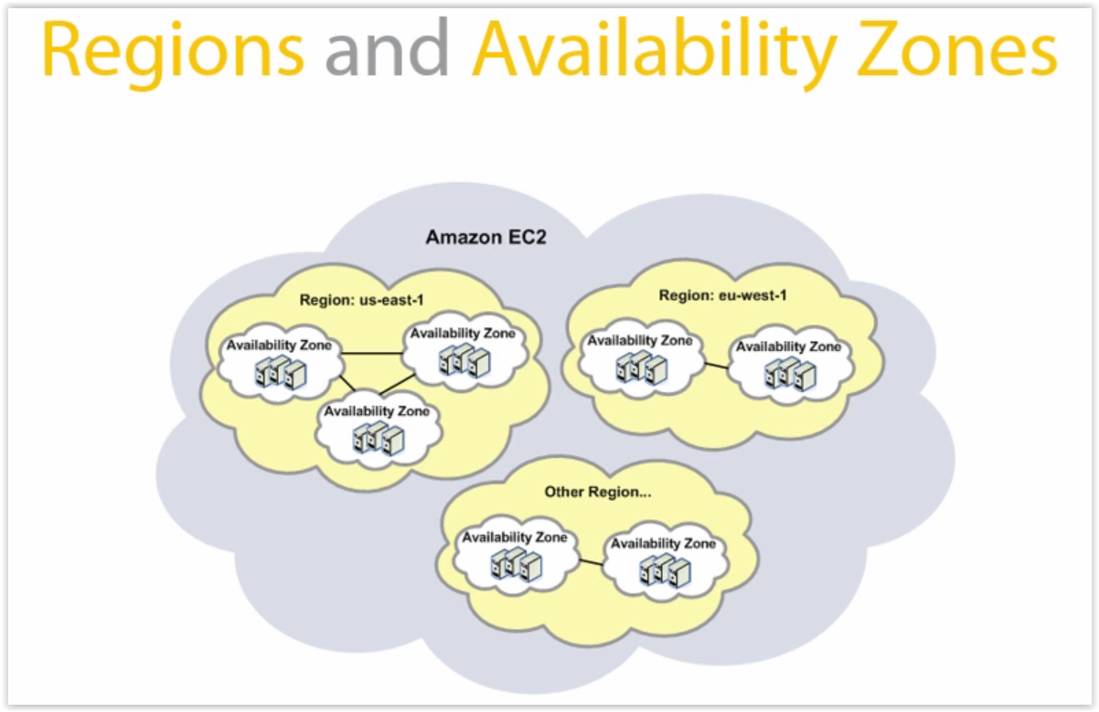

Slide 13
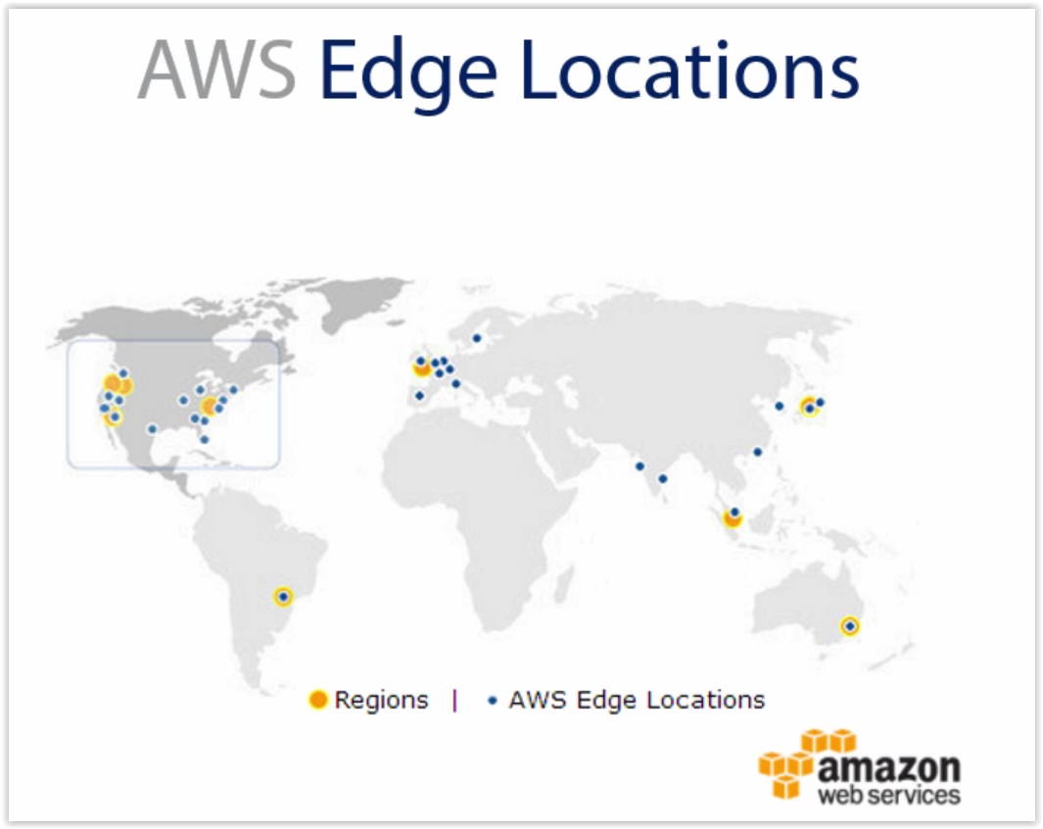

Slide 14
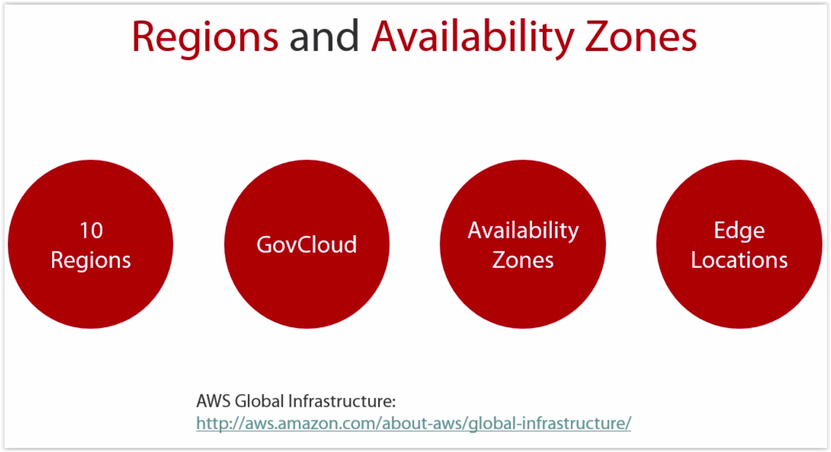

Slide 15
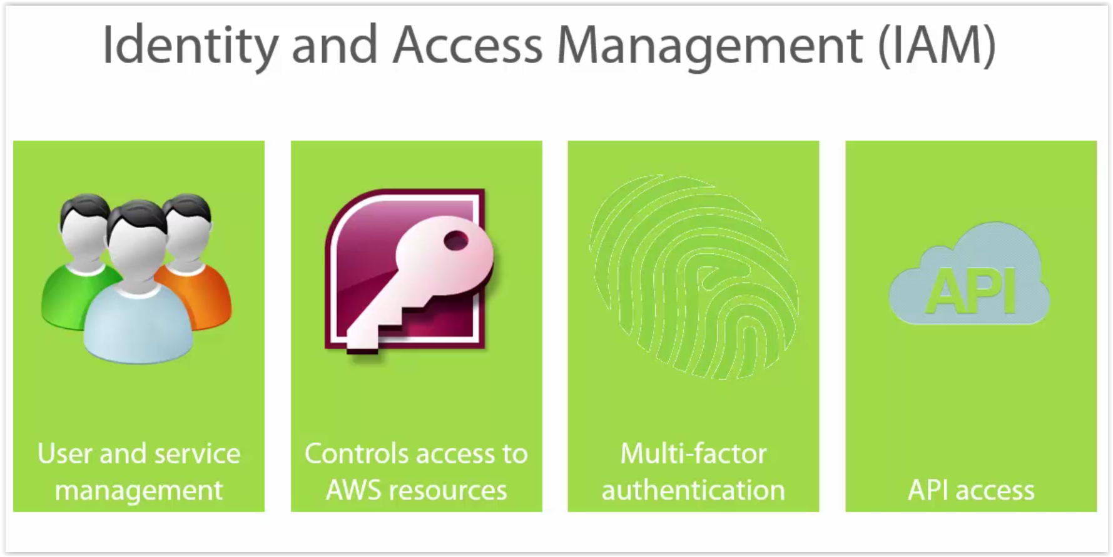

Slide 16
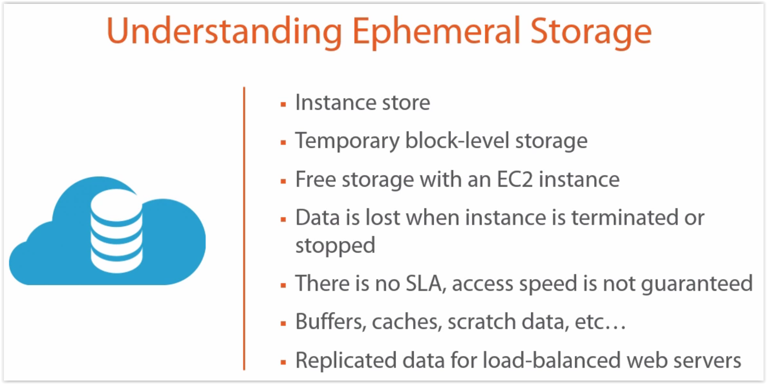
Ephemeral & S3 Storage(1)

Slide 17
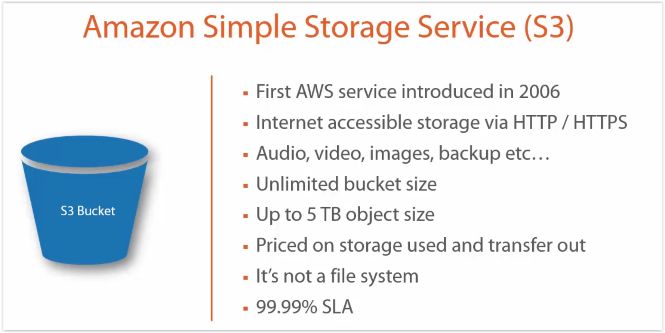
Ephemeral & S3 Storage(2)

Slide 18
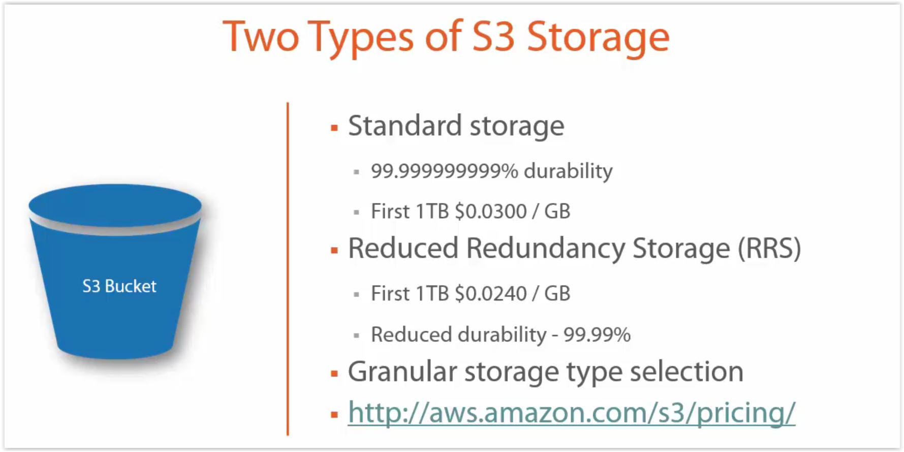
Ephemeral & S3 Storage(3)

Slide 19
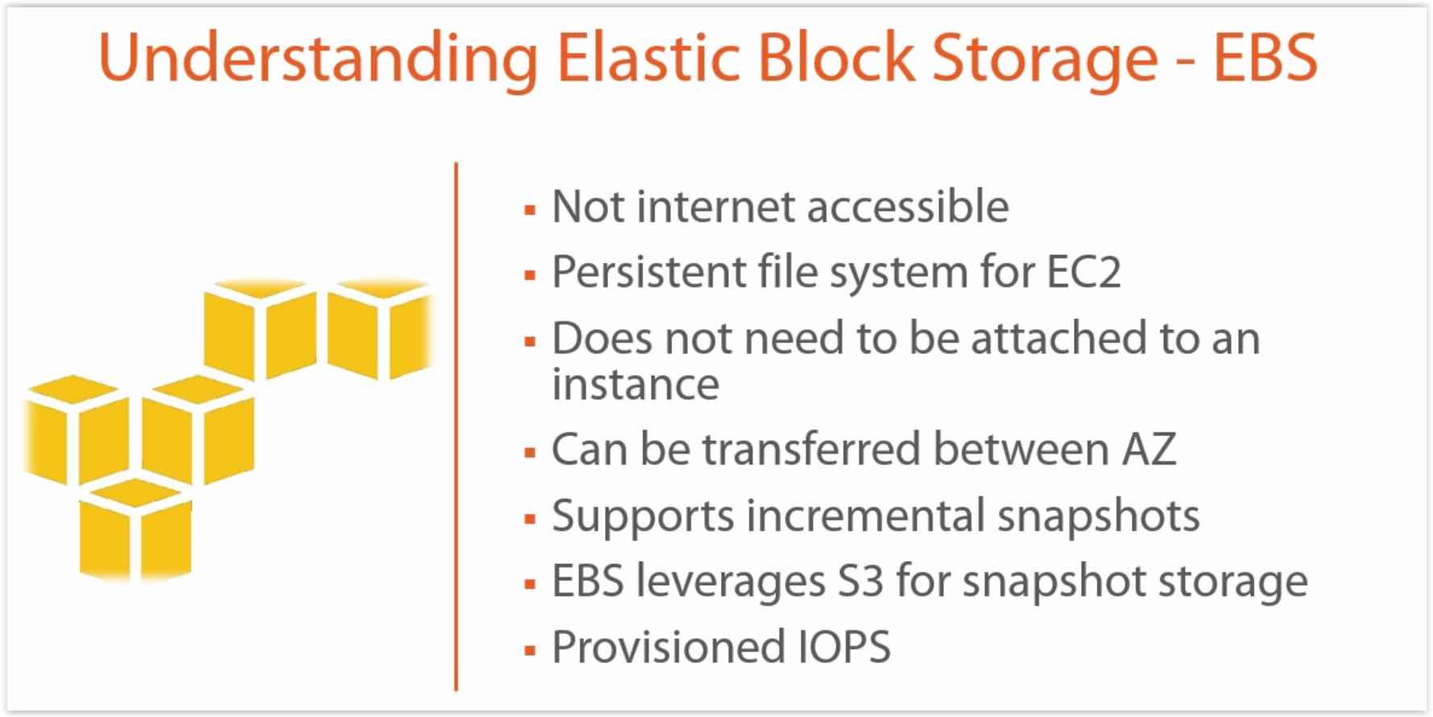
Other AWS Storage Services

Slide 20
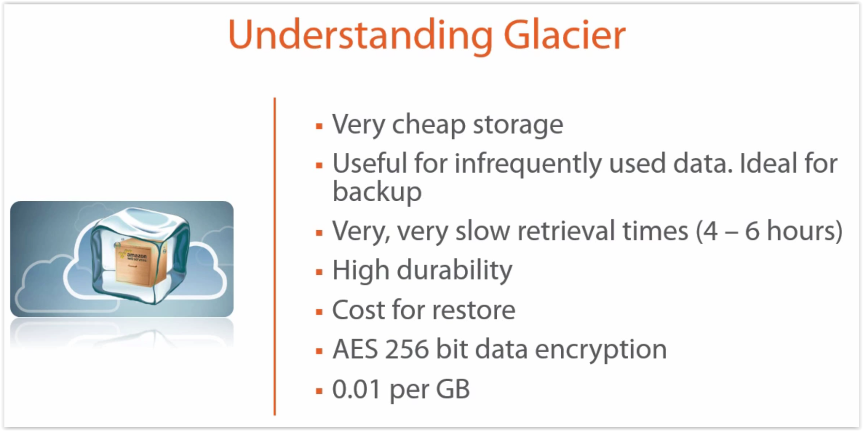
Other AWS Storage Services

Slide 21
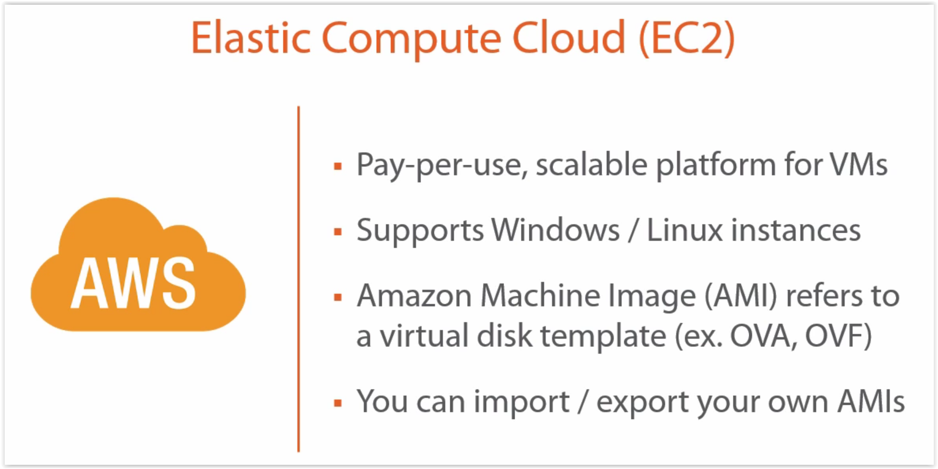
Welcome to EC2

Slide 22
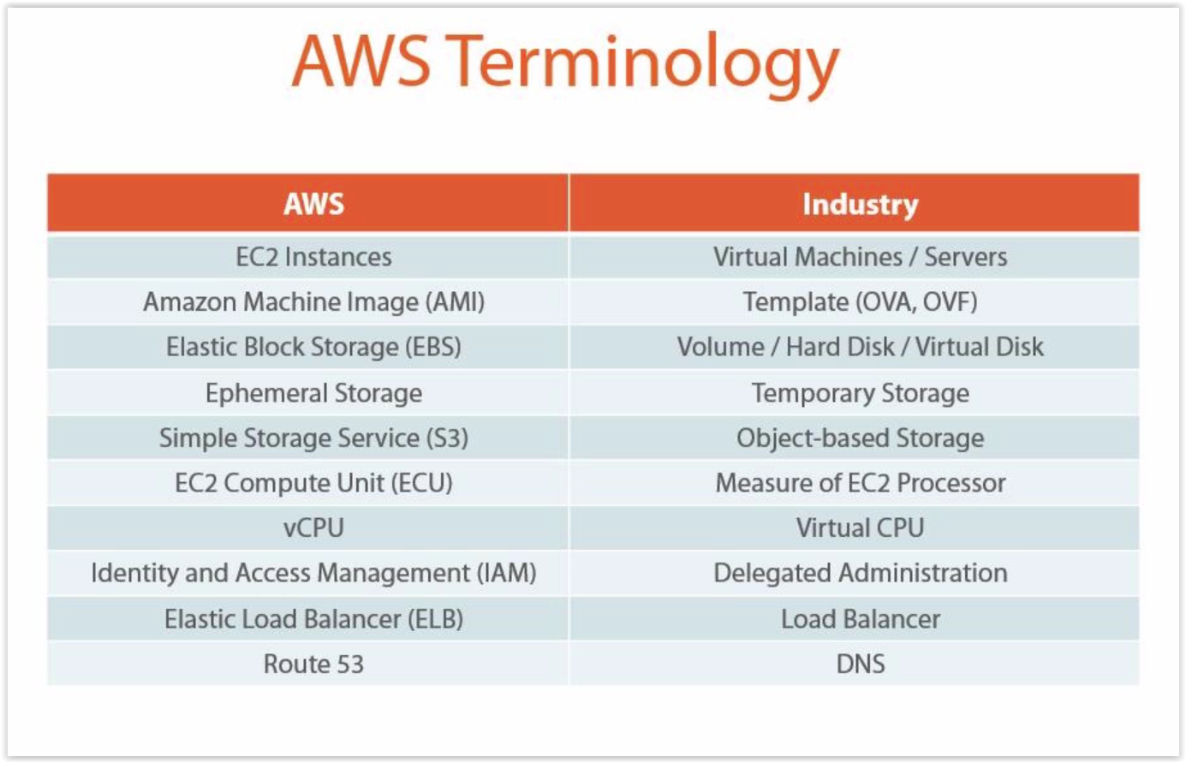
Welcome to EC2(2)

Slide 23
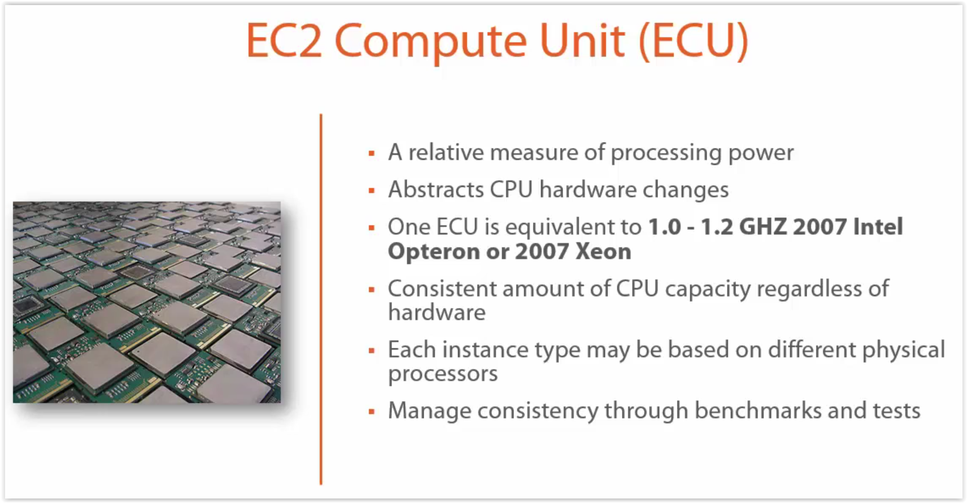
Welcome to EC2(3)

Slide 24
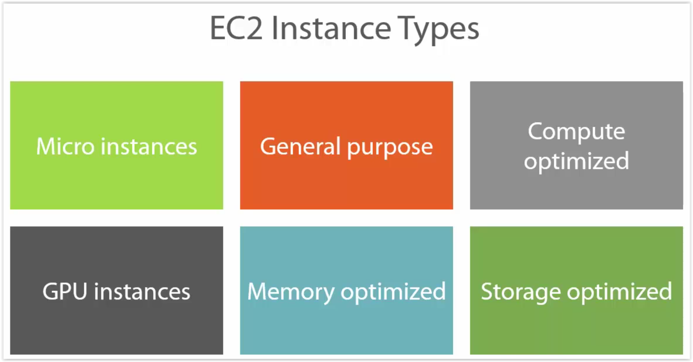
Welcome to EC2(4)

Slide 25
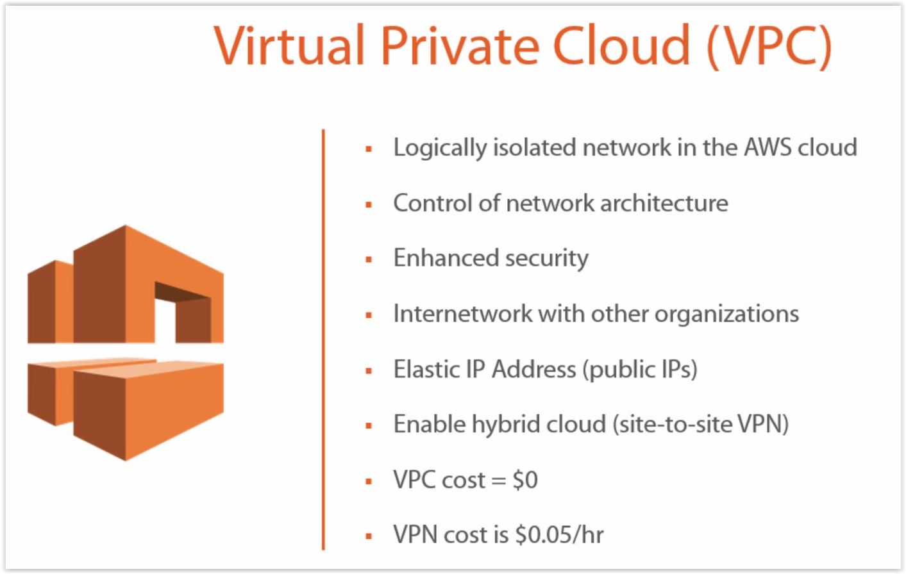
What is VPC ?

Slide 26
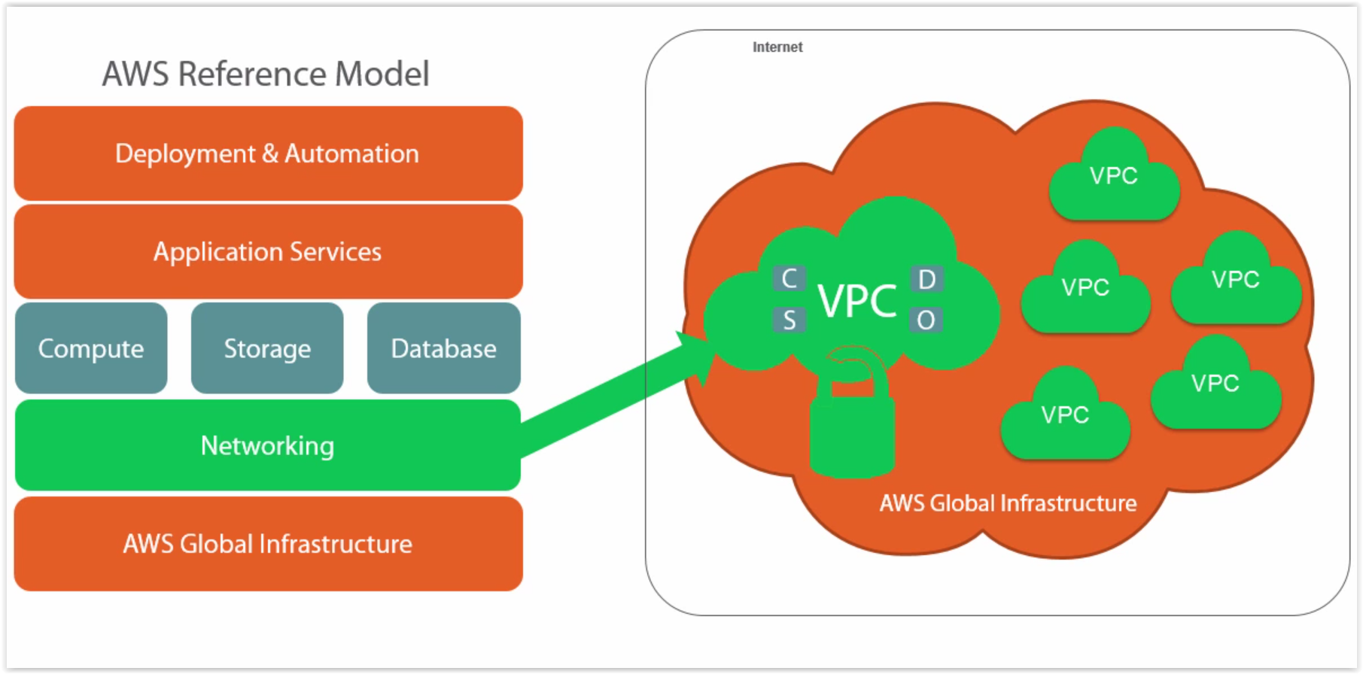
What is VPC ? (2)

Slide 27
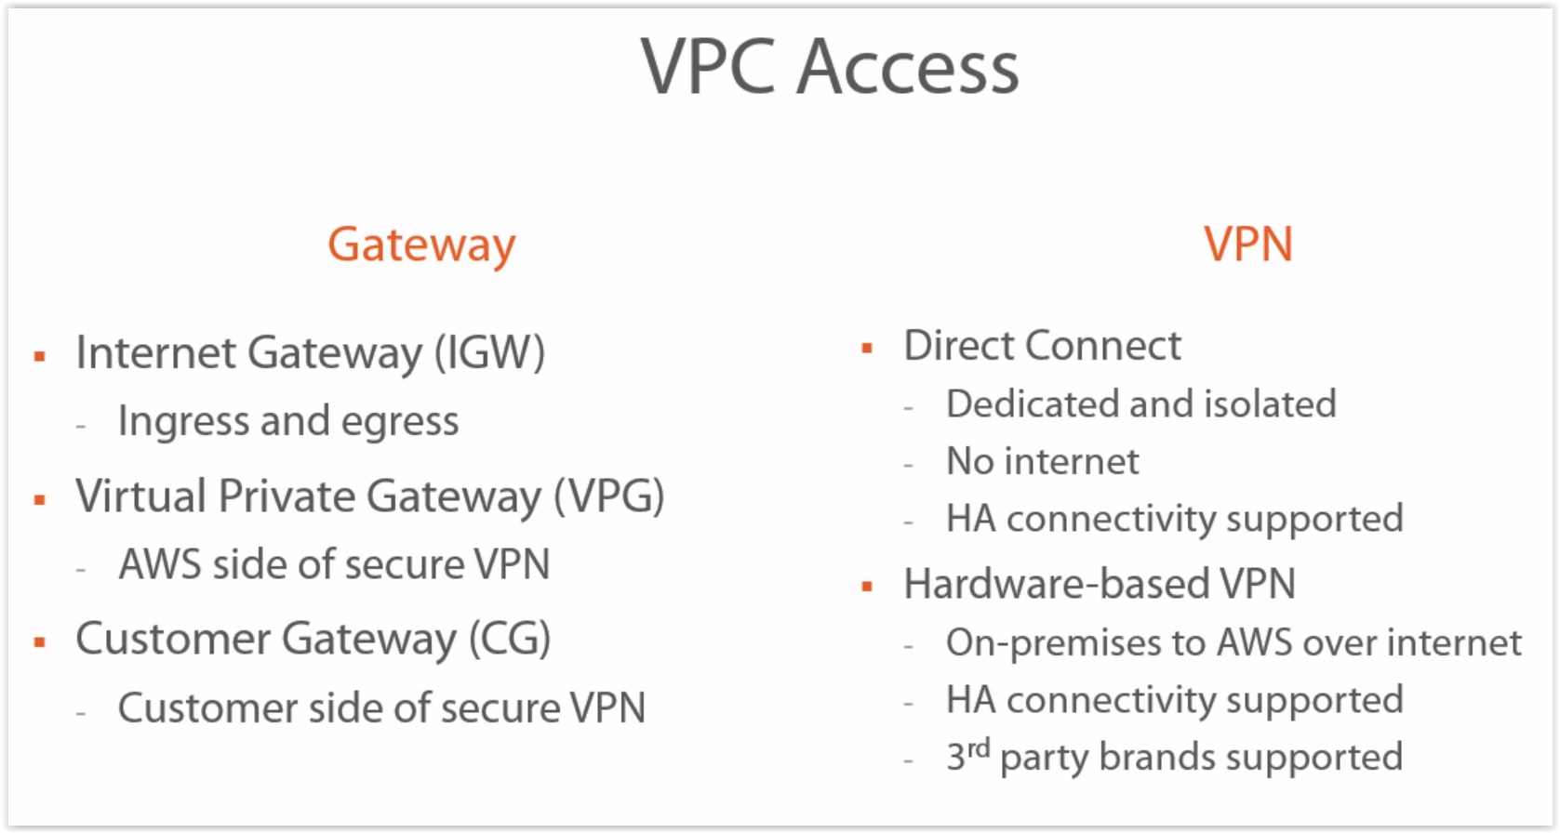
What is VPC ? (3)

Slide 28
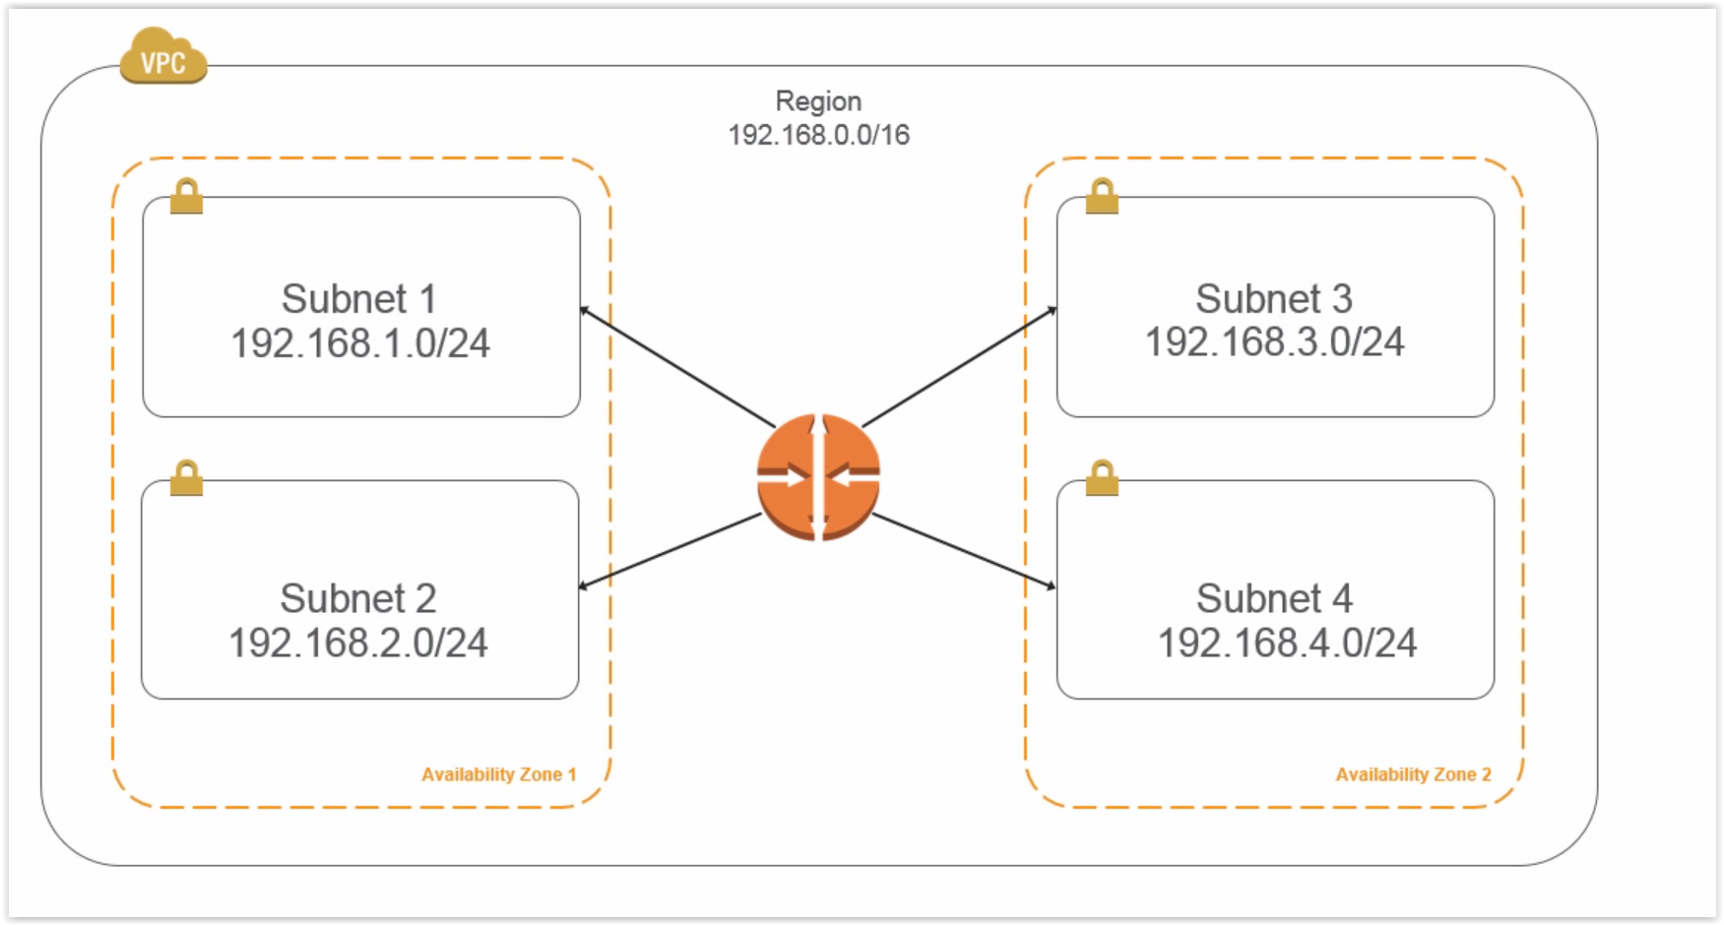
VPC Schema

Slide 29
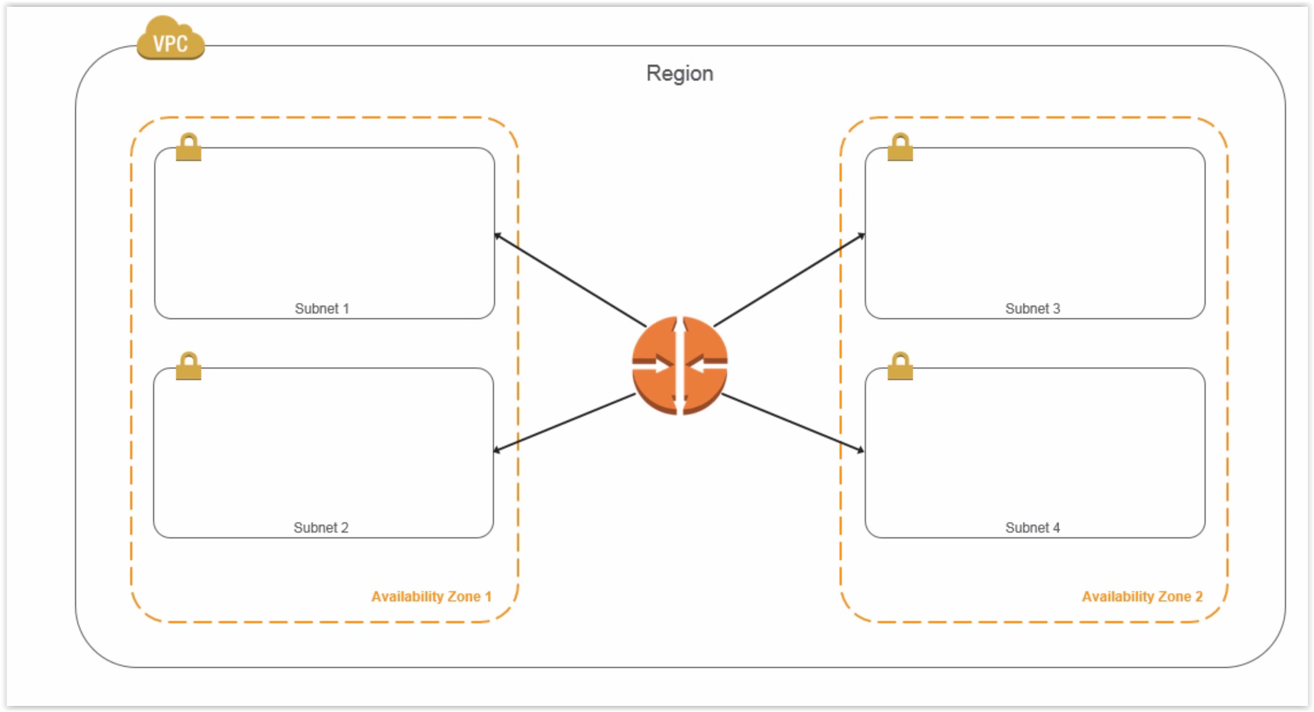
VPC Schema

Slide 30
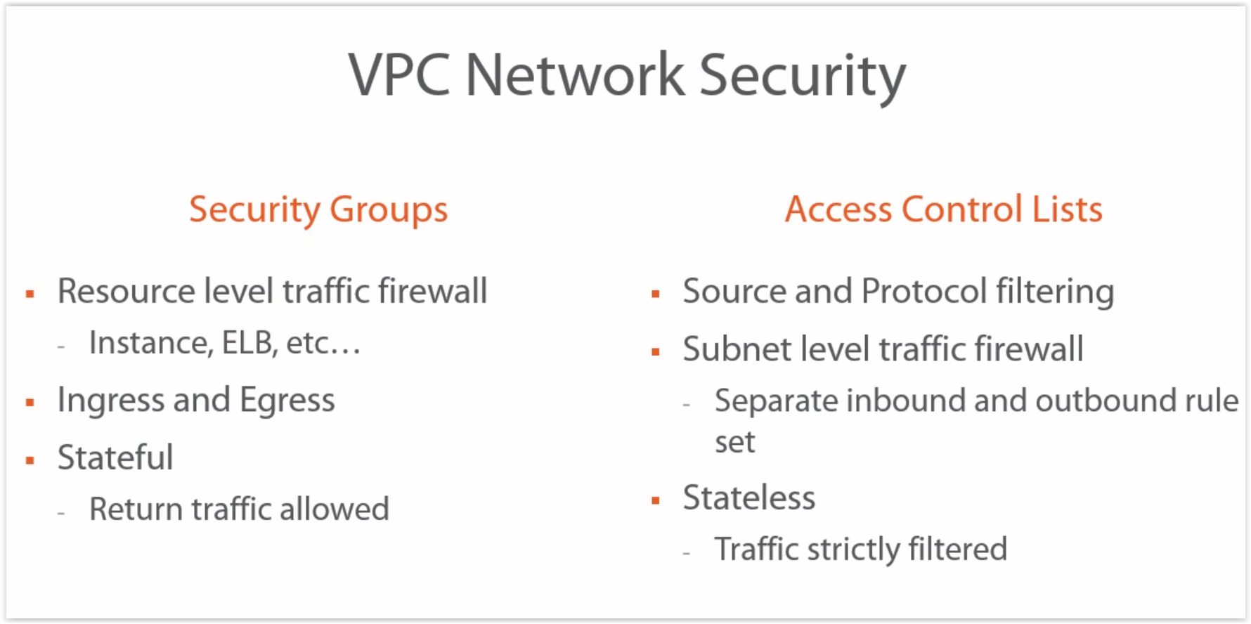
VPC Security

Slide 31
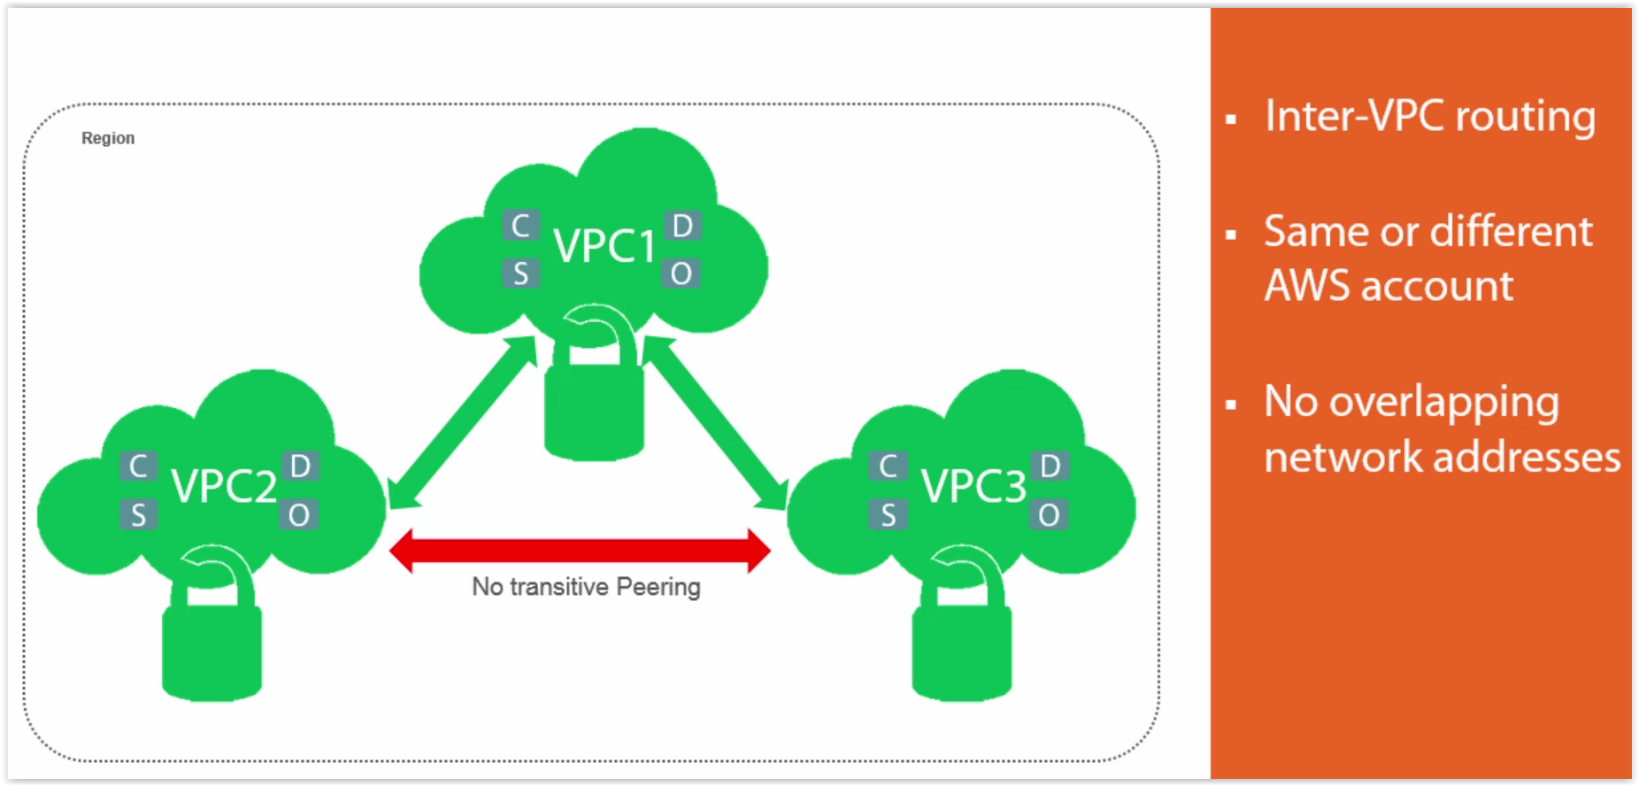
VPC Peering

Slide 32
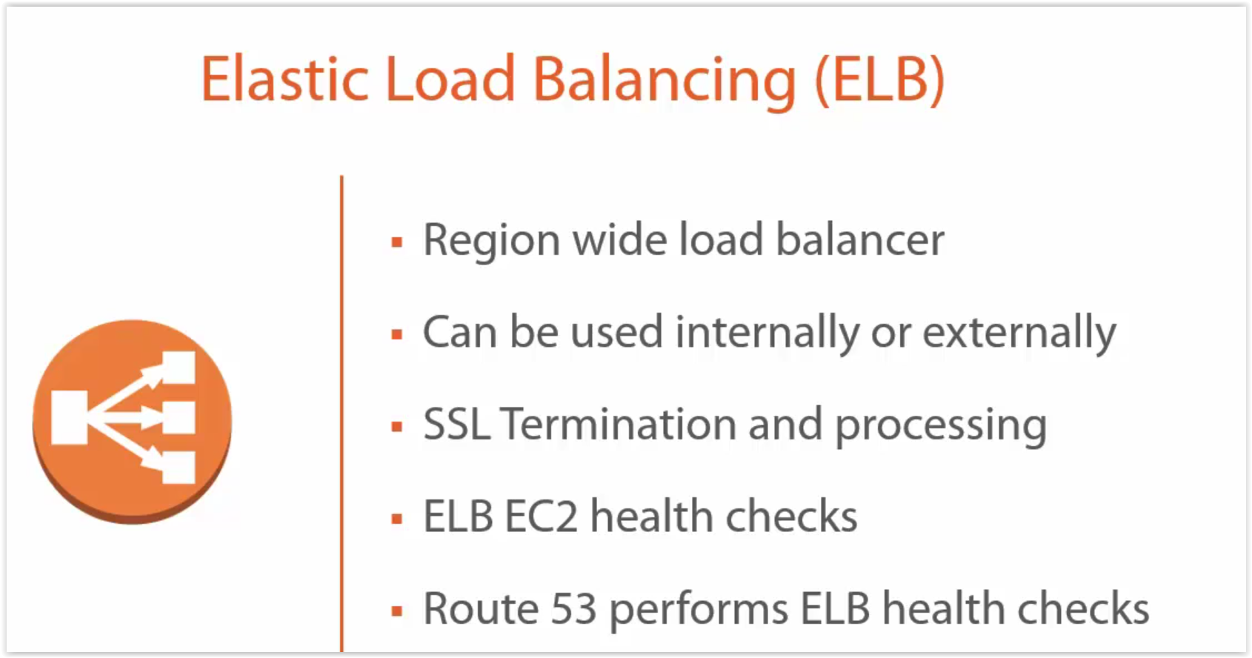
What is ELB ?

Slide 33
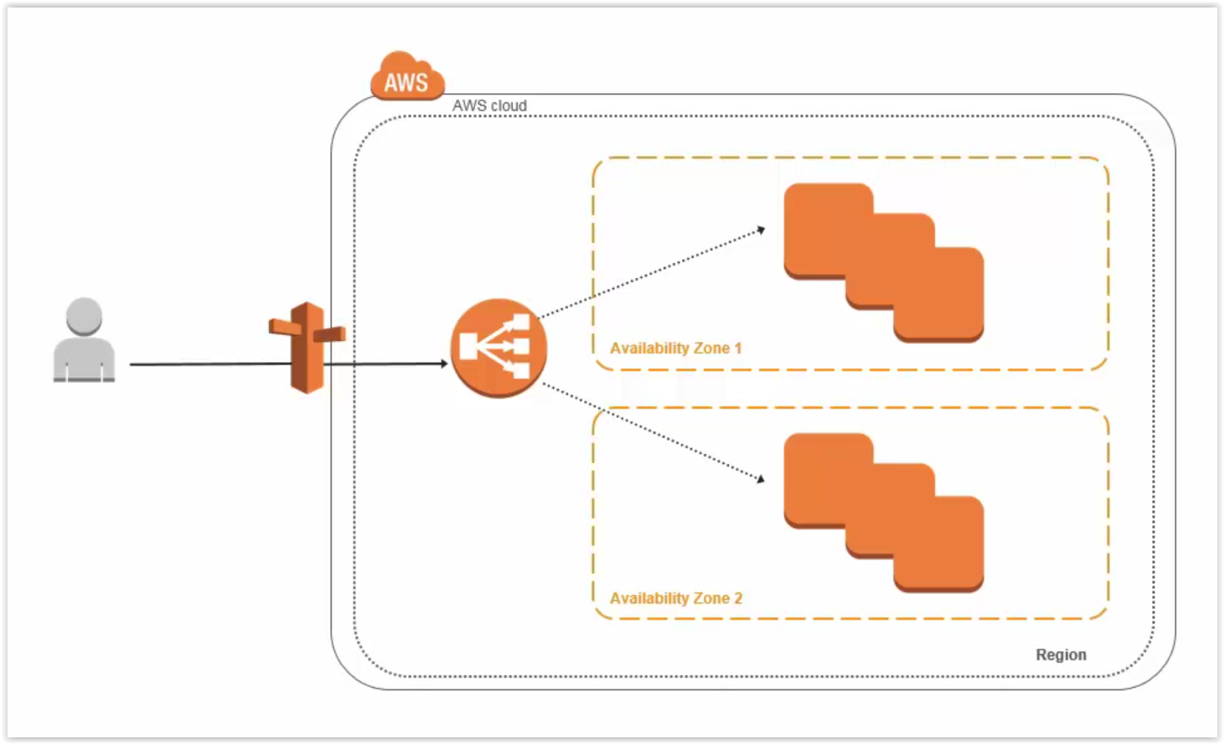
What is ELB ?

Slide 34
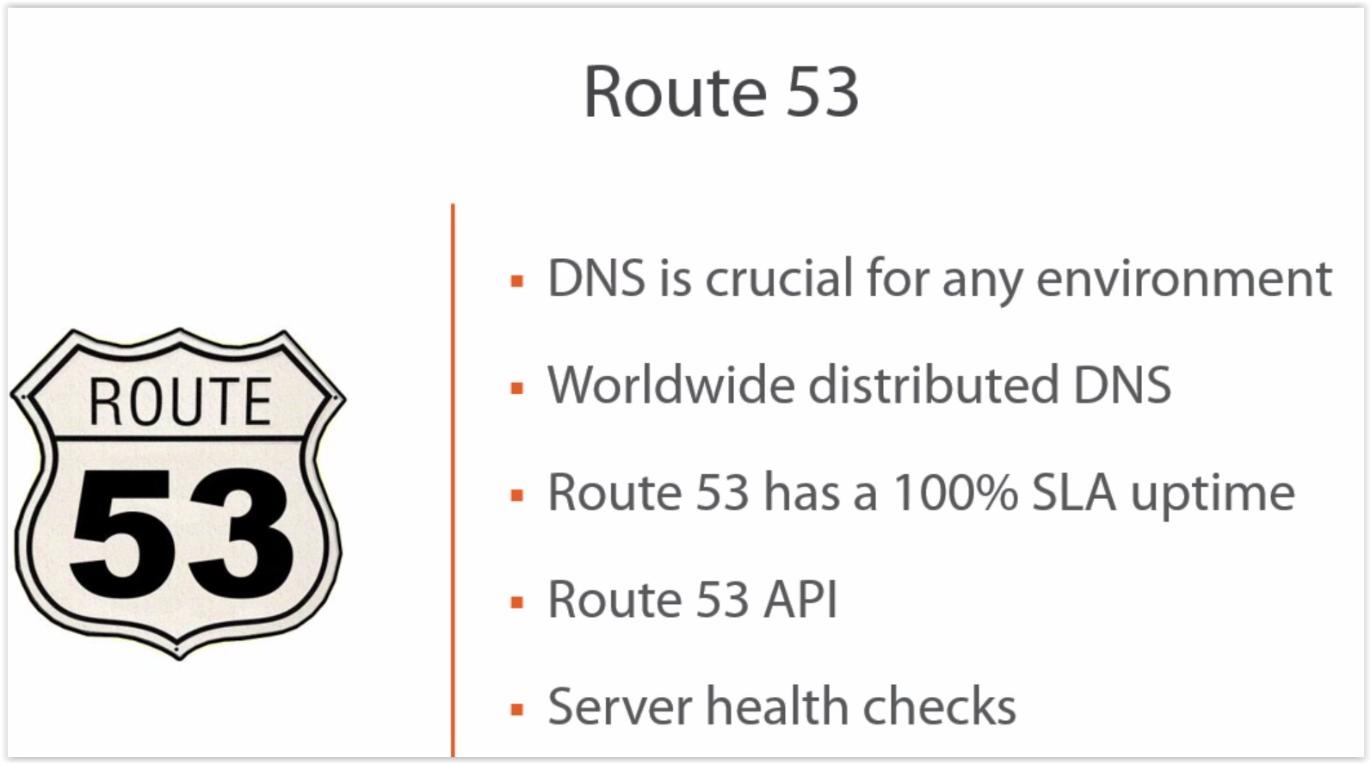
AWS ROUTE 53

Slide 35
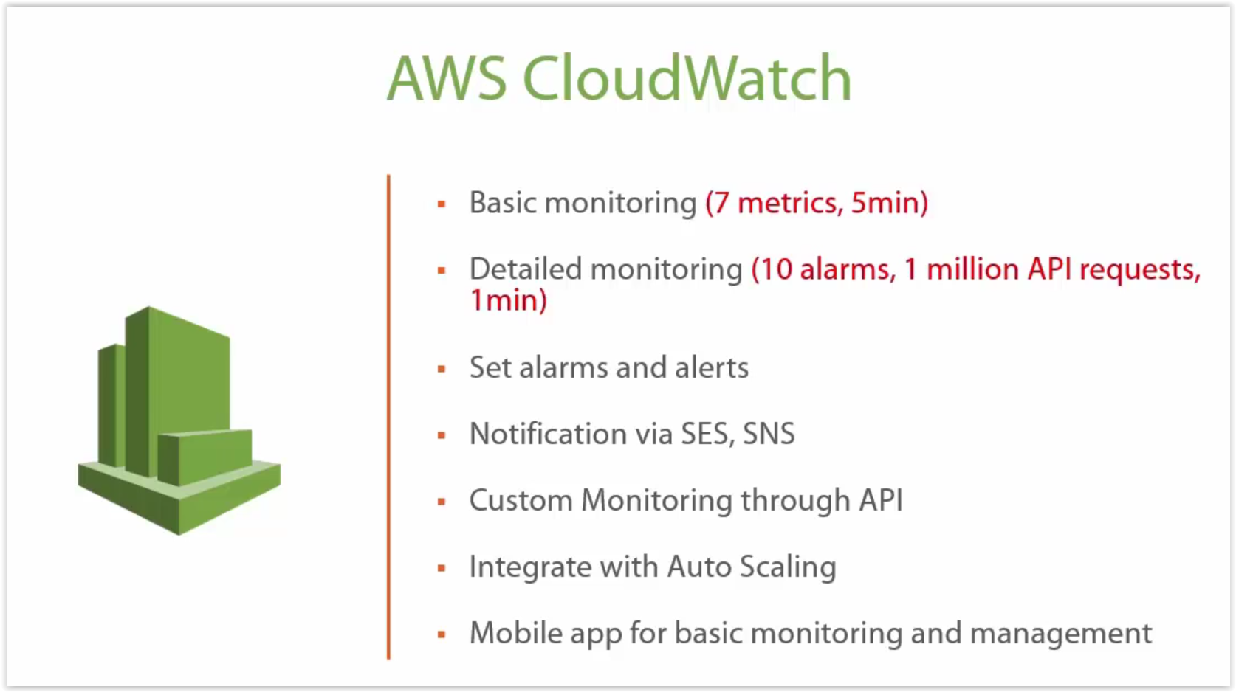
CLOUDWATCH

Slide 36
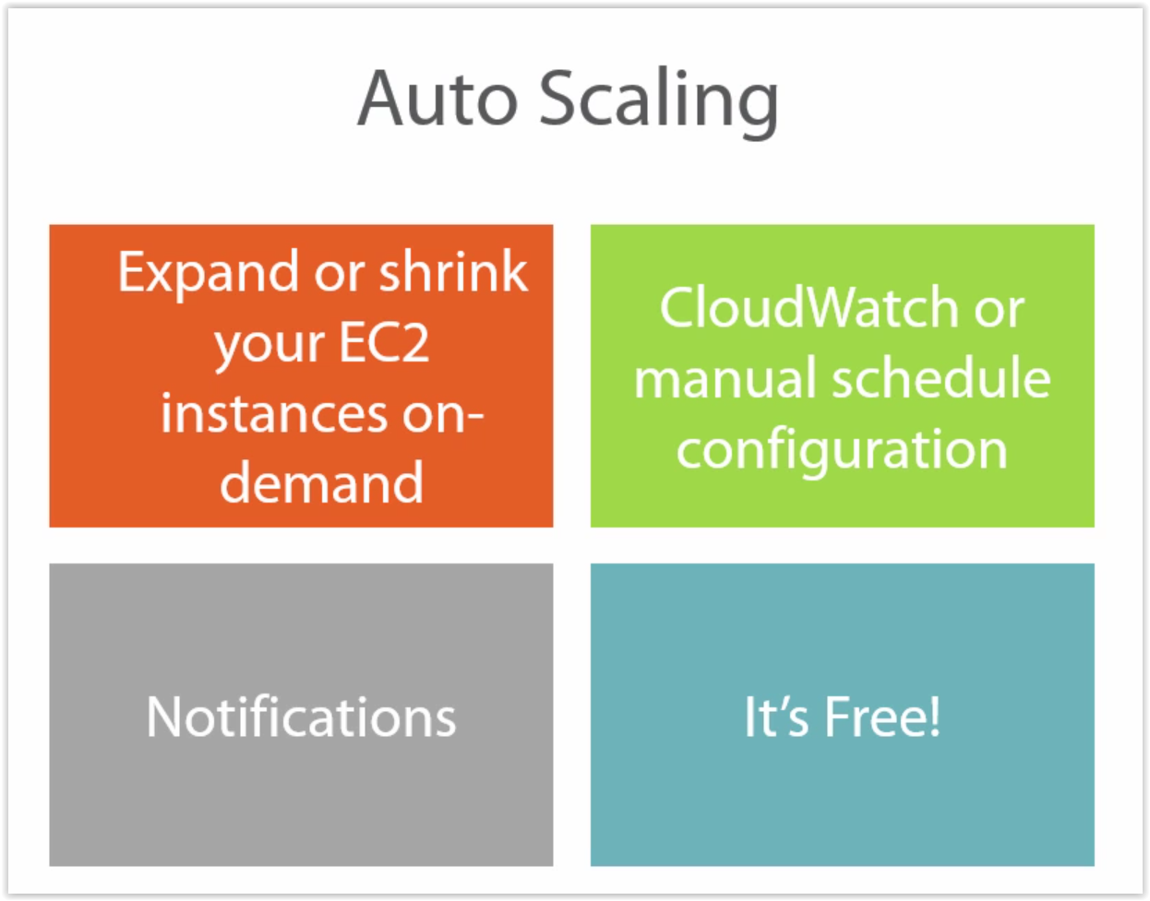
AWS AUTOSCALING

Slide 37
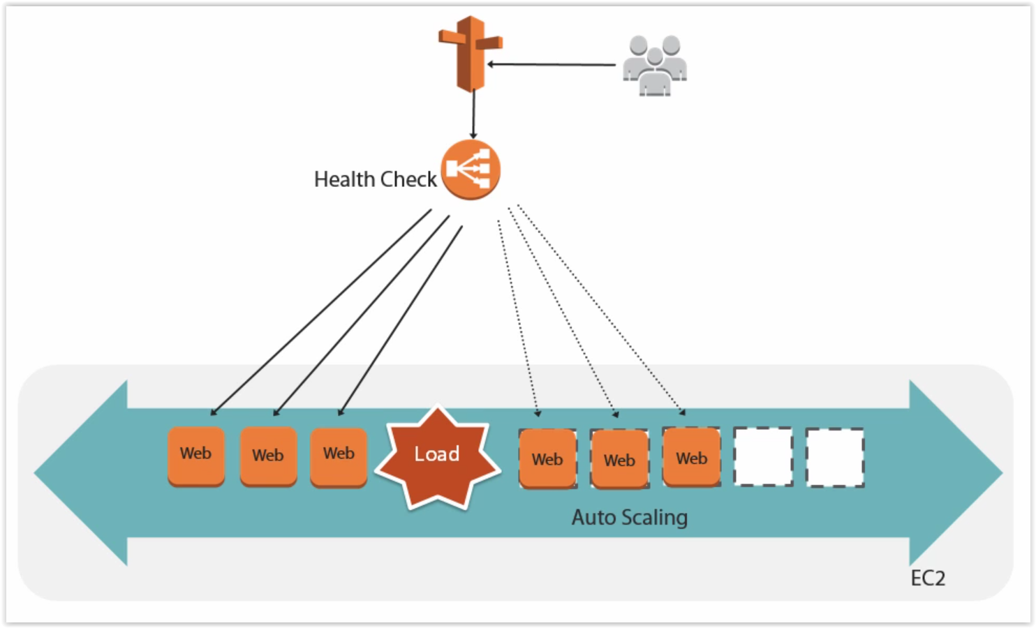
How auto scaling works

Slide 38
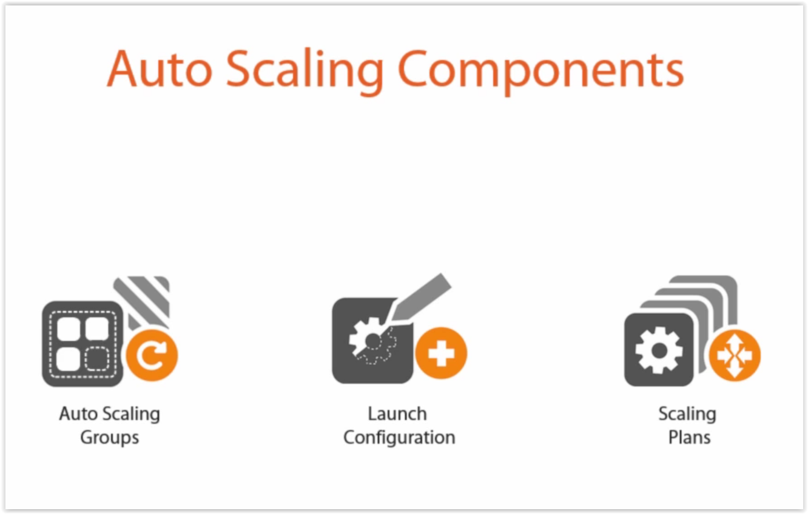
AUTO SCALING COMPONENTS

Slide 39
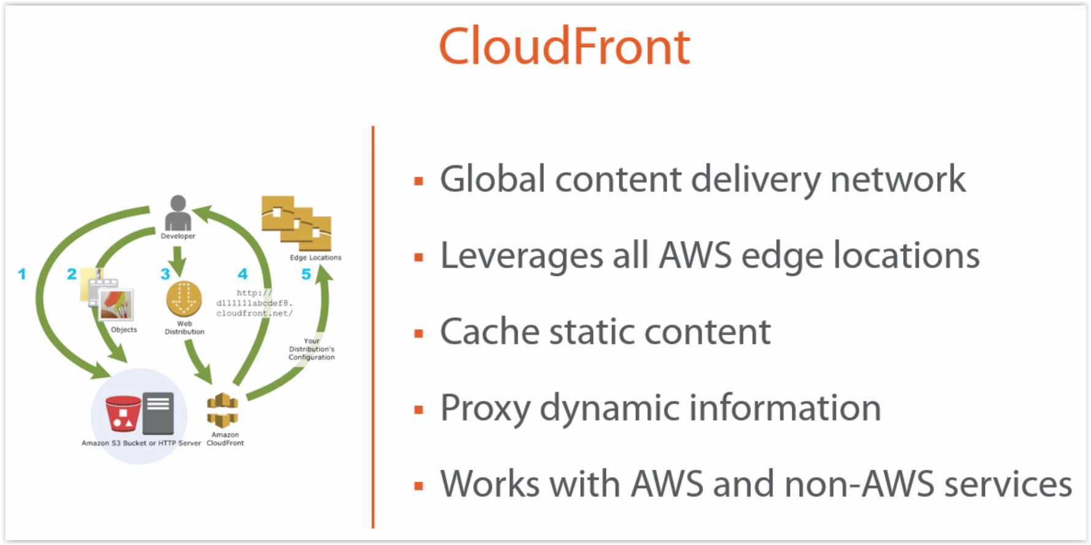
CDN

Slide 40
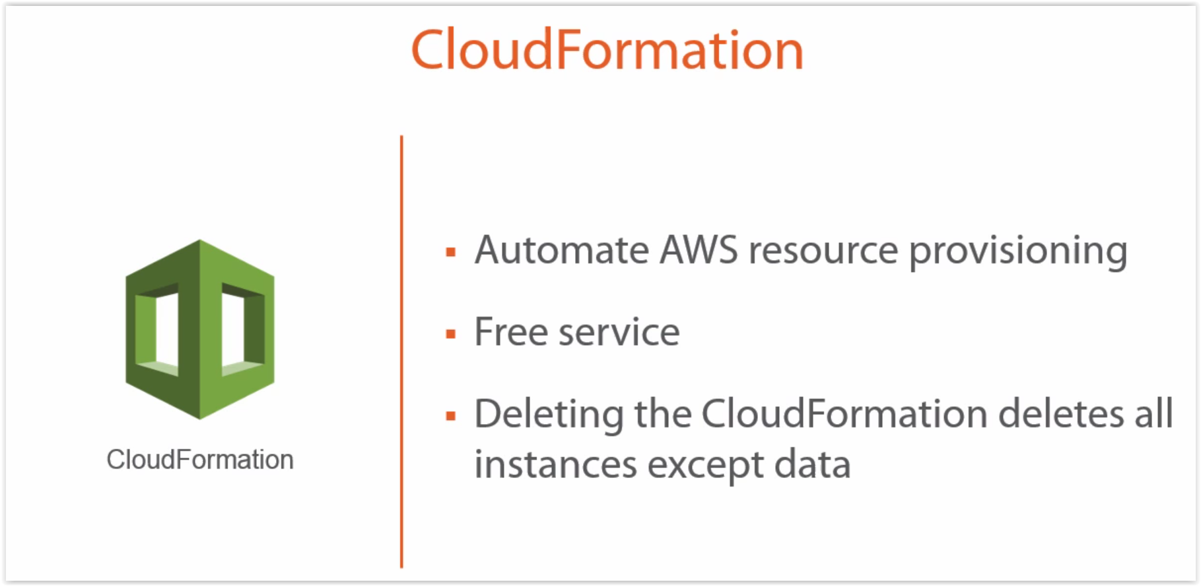
CloudFormation

Slide 41
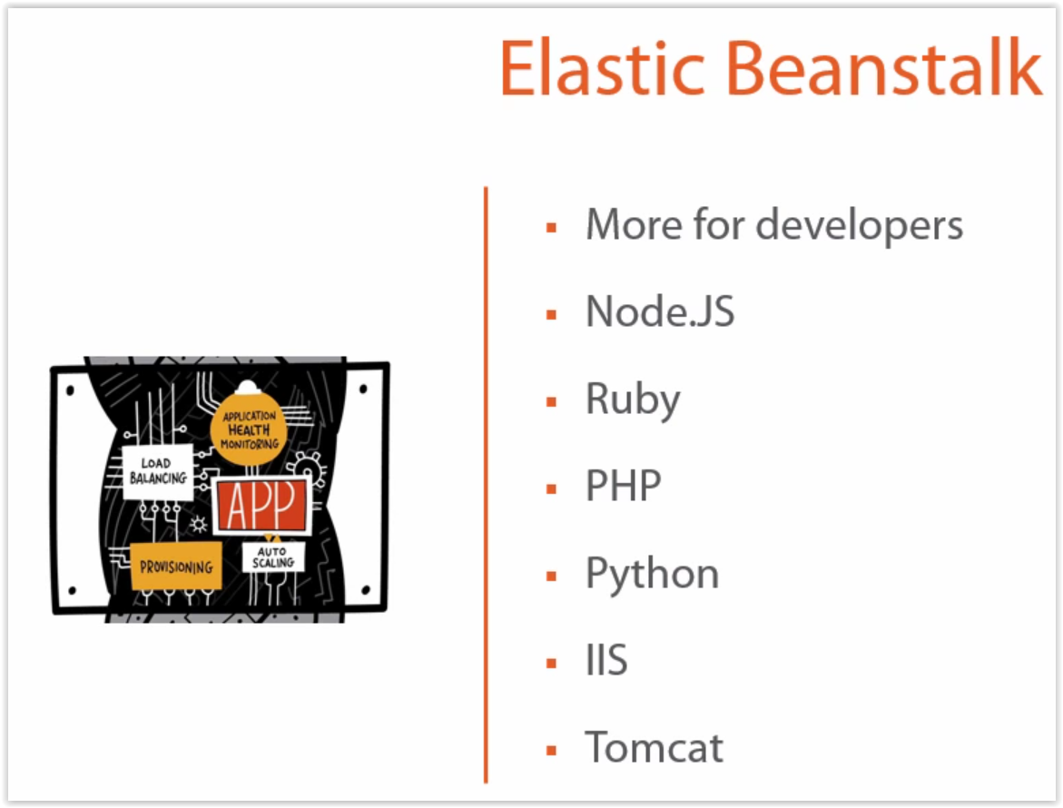
ELASTIC BEANSTALK

Slide 42
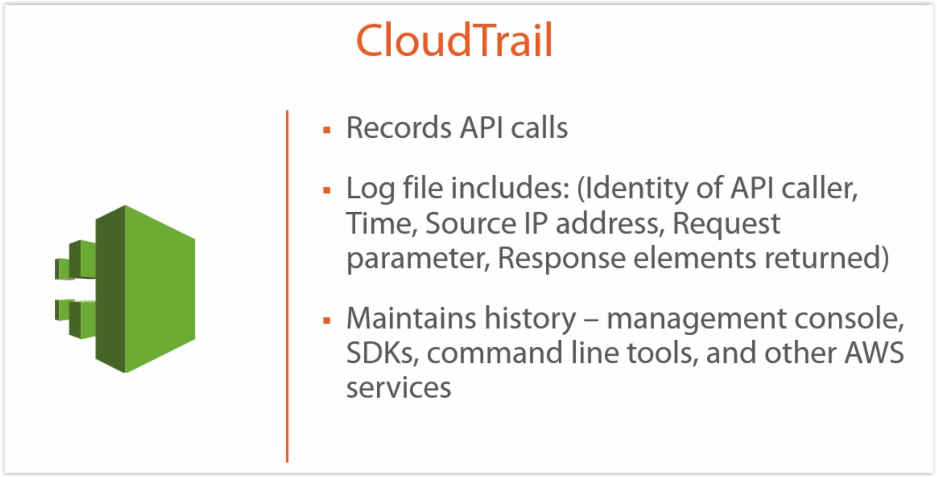
CLOUDTRAIL

Slide 43
IaaS Models
Ad-hoc change management
Configuration synchronization
Immutable infrastructure
Containerized services

Slide 44
Ad-hoc Change Management
Makes changes to servers only when a specific change is needed
Traditional, pre-automation approach :
log into a server -> edit files ->install packages->create user accounts
Problem with this is that it leads to configuration drift and the automation fear cycle

Slide 45
Configuration Synchronization
Repeatedly applies configuration definitions to servers (example: by running a Puppet or Chef agent on an hourly schedule
Any changes made outside of the automation are brought back into line with the definitions
This discourages ad-hoc changes

Slide 46
Configuration Synchronization
Guarantees that every server is up to date, having had all of the current configuration definitions applied
Limitation of configuration synchronization is that it’s not feasible to have configuration definitions covering a significant percentage of a server

Slide 47
Immutable Infrastructure
Make configuration changes by completely replacing servers
A change is made by building a new version of a server template (such as an AMI)
This increases predictability, since there is little variance between servers as tested, and servers in production
Packer is the go-to tool for building server images

Slide 48
Containerized Services
Works by packaging applications and services in lightweight containers
Reduces coupling between server configuration and the things that run on the servers
Container host servers still need to be managed using one of the other models

Slide 49
Why IaC ?
Your IT infrastructure supports and enables change, rather than being an obstacle or a constraint for its users
Changes to the system are routine, without drama or stress for users or IT staff
IT staff spends their time on valuable things which engage their abilities, not on routine, repetitive tasks

Slide 50
Why IaC ?
Users are able to responsibly define, provision, and manage the resources they need, without needing IT staff to do it for them
Teams are able to easily and quickly recover from failures, rather than assuming failure can be completely prevented
Improvements are made continuously, rather than done through expensive and risky “big bang” projects

Slide 51
Tools for IaC
Terraform is a tool for building, changing, and versioning infrastructure safely and efficiently
AWS CloudFormation gives developers and systems administrators an easy way to create and manage a collection of related AWS resources

